Slide 1
Tree of Heaven Webinar

Slide 2
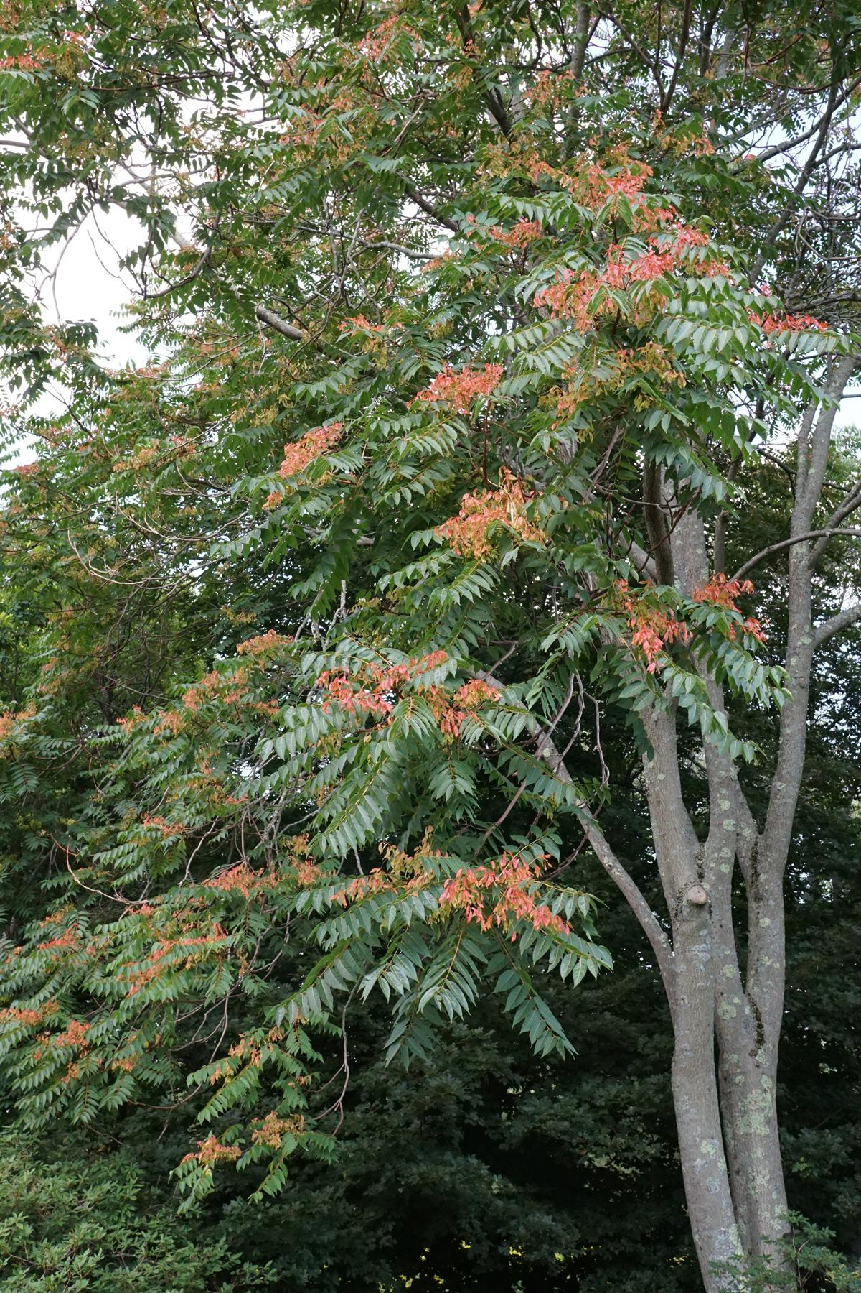
Webinar Agenda
Tree of Heaven background and identification
Pests - spotted lantern fly and brown marmorated stinkbug
Re-sprouting properties
Management/treatment methods
Q & A

Slide 4
Tree of Heaven (Ailanthus altissima)
Notes:
Tree of heaven is native to China and was brought to the East Coast in the late 1700s as a hardy street tree. It was brought to California during the gold rush by Chinese immigrants as a cultural and medicinal tree. Its leaves, roots, and bark were used as traditional Chinese medicine, primarily as an astringent.
It is a potentially large, compound-leaf deciduous tree that typically spreads in California by root sprouts rather than by seeds. If a live tree is cut, its shallow roots sprout vigorously within a 50 to 100-foot radius.

Slide 5
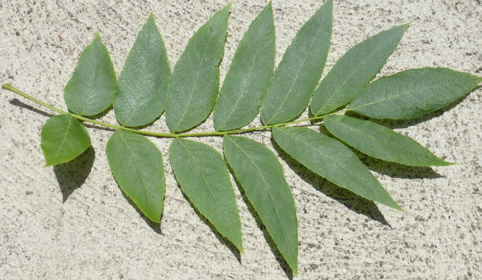
Leaves are similar to black walnut, but larger
Black Walnut
©2016 Zoya Akulova
Tree of heaven
©2014 Dr. Amadej Trnkoczy
Notes:
Tree of heaven leaves are pinnately compound and can be confused with black walnut. The tree of heaven leaflet edge is smooth, while the black walnut leaflet has small teeth. Tree of heaven leaves are typically longer than black walnut and have more leaflets. Leaf petioles are often red.

Slide 6
Leaflets have glandular teeth at the base
©2012 Julie Kierstead Nelson
Notes:
The best tree of heaven leaf diagnostic is the glandular “teeth” at the base of most leaflets. And crushed leaves have a noticeable ‘unpleasant’ smell.
Leaves and all plant parts give off a strong, offensive odor

Slide 7
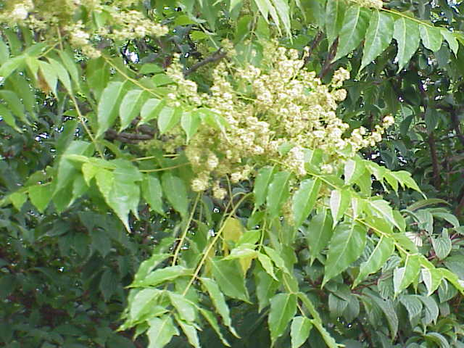
Photo: Dave Jackson
By Kurt Stüber [1] - caliban.mpiz-koeln.mpg.de/mavica/index.html part of www.biolib.de, CC BY-SA 3.0, https://commons.wikimedia.org/w/index.php?curid=3338
Notes:
Tree-of-heaven is dioecious, meaning a tree is either male or female, and typically grows in dense colonies, or "clones." All trees in a single clone are the same sex. Female trees are prolific seeders with the potential to produce more than 300,000 seeds annually. The single-seeded samaras are wind-dispersed.
Established trees continually spread by sending up root suckers that may emerge as far as 50 feet from the parent tree. A cut or injured tree-of-heaven may send up dozens of stump and root sprouts. Root sprouts as young as two years are capable of producing seed. Tree-of-heaven produces allelopathic chemicals in its leaves, roots, and bark that can limit or prevent the establishment of other plants.
The foliage can cause contact dermatitis. TOH pollen is a common allergen.

Slide 8
Springtime“redish” leafing out at branch tips
Notes:
Tree-of-heaven is deciduous, dropping its leaves in the winter. Leaves yellow and fall off in late October to November.
Trees start leafing out again in late March and early April.

Slide 9
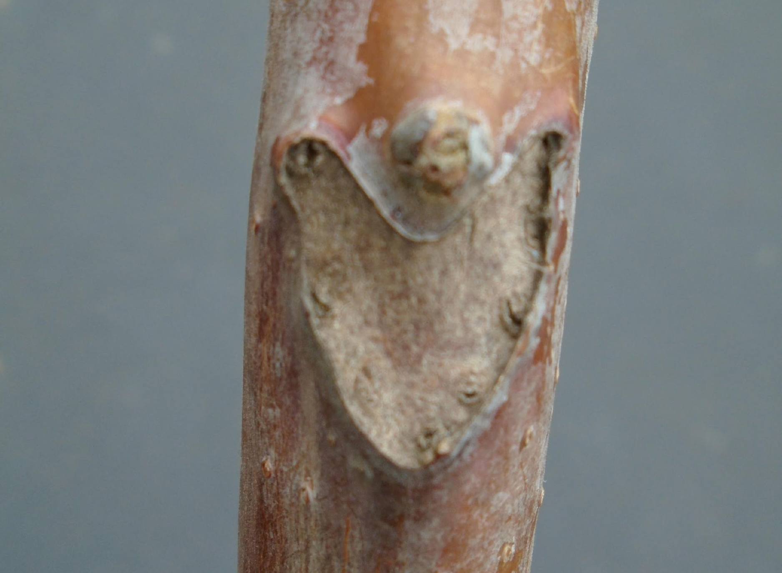
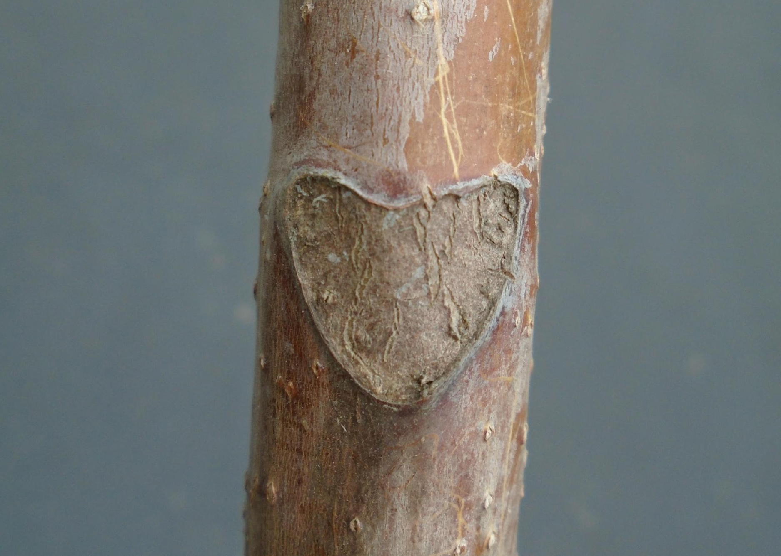
Gray “cantaloupe skin” bark
Heart-shaped leaf scars
Notes:
Trees have a gray “cantaloupe skin” bark, heart-shaped leaf scars.

Slide 10
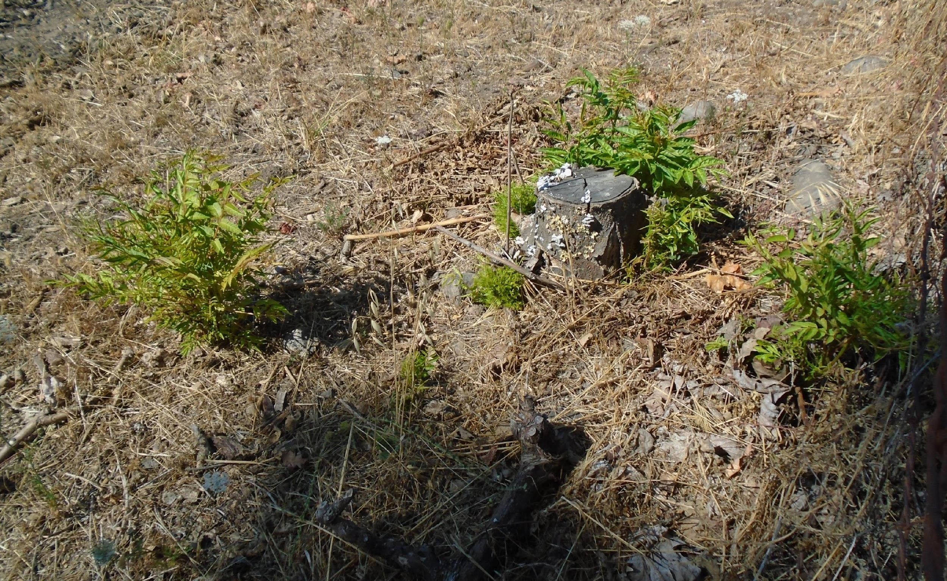
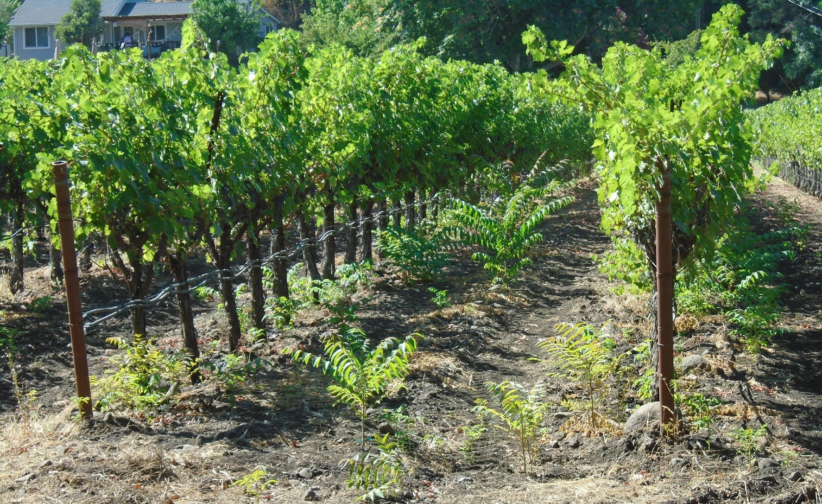
A cut, burned, or otherwise damaged tree of heaven sprouts vigorously from its roots.
Even in adjacent vineyards.

Slide 11
Tree of heaven root sprout thicket
Notes:
Root sprouts create a thicket. Thickets are often clones of an original tree, therefore either all male or female.
Most reproduction in California is from root sprouts (Leif disagrees)

Slide 12
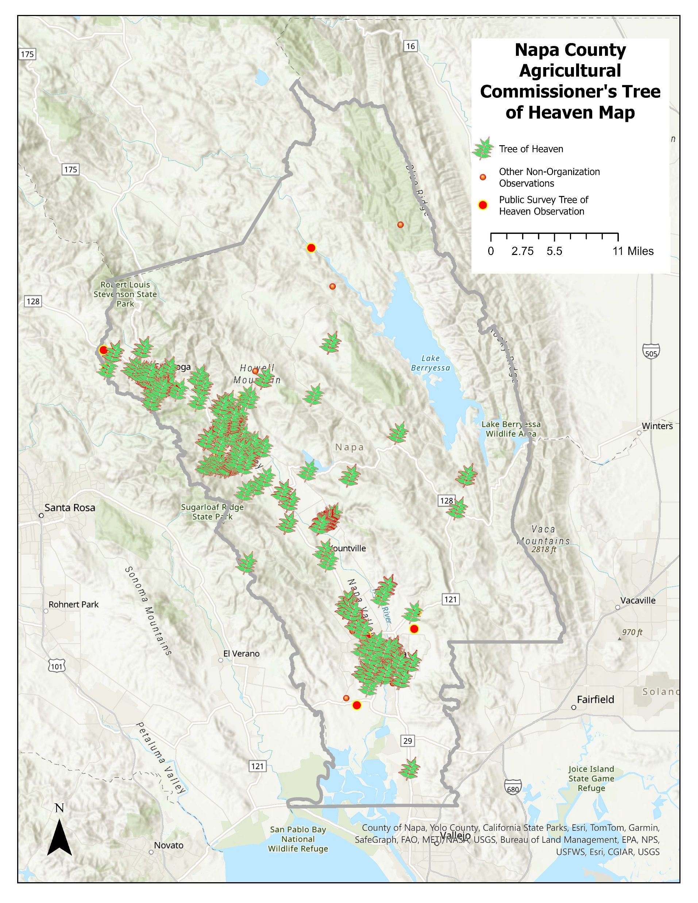
The Napa County Ag Commissioner’s office
is mapping tree of heaven in
Napa County.
Notes:
Tree of heaven is sporadically present in Napa Valley, mostly along the upper Napa River and tributary creeks. Particularly Sulphur Creek and Diamond Mountain Creek. Along Silverado Trail near St. Helena. In southern St. Helena.

Slide 13
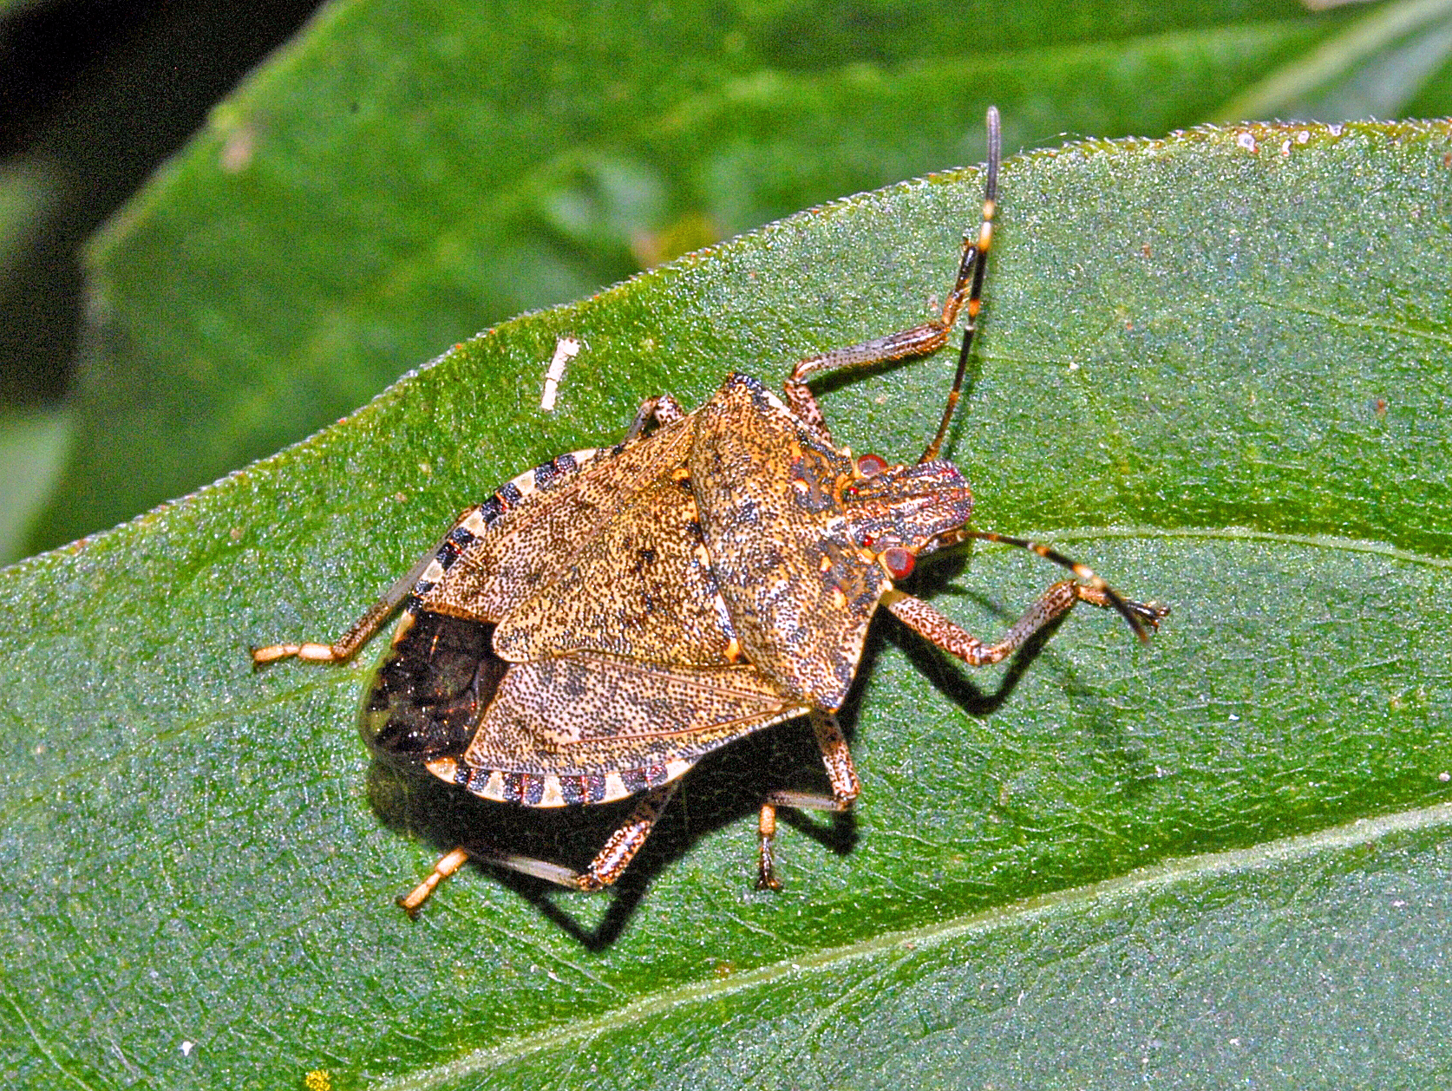
It is a host to the Brown Marmorated Stinkbug
Notes:
This was a potential concern before BMSB became established in Napa County a few years ago. But BMSB has low population levels and does not seem to be any problem for winegrapes.

Slide 14
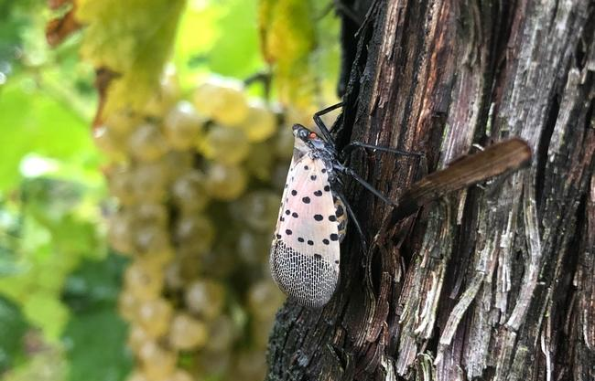
It is a Host to the Spotted Lanternfly
Notes:
Tree of heaven is the favored host plant to spotted lanternfly, an invasive sap-feeding planthopper from China that is a potential threat to vineyards.

Slide 15
Known Spotted Lanternfly distribution as of December 2024

Slide 16
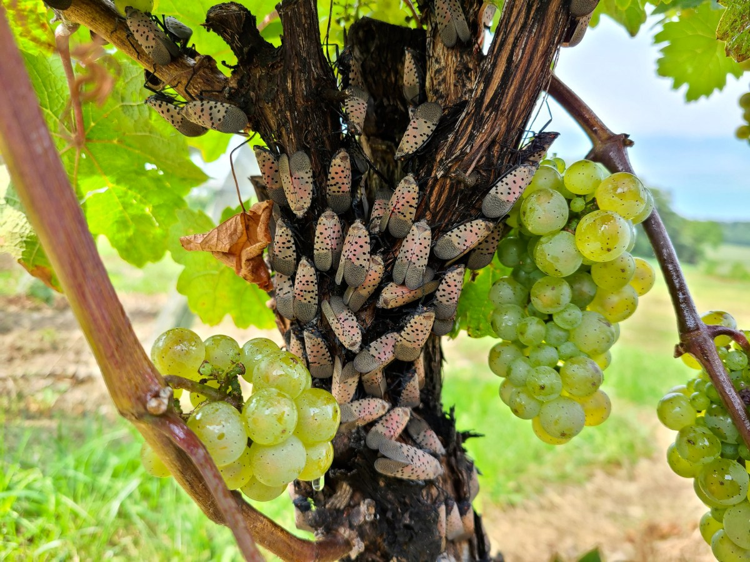
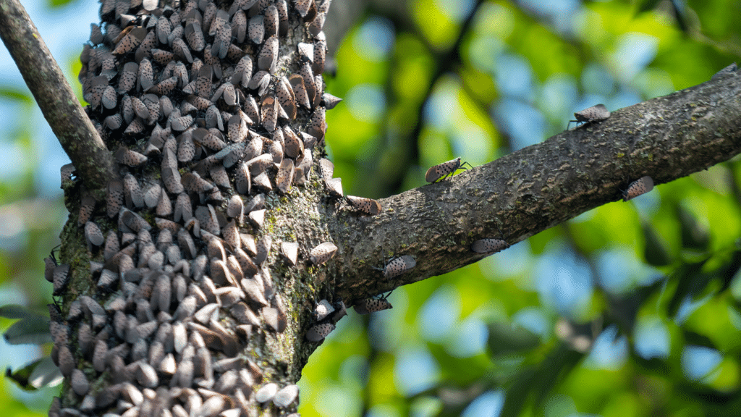
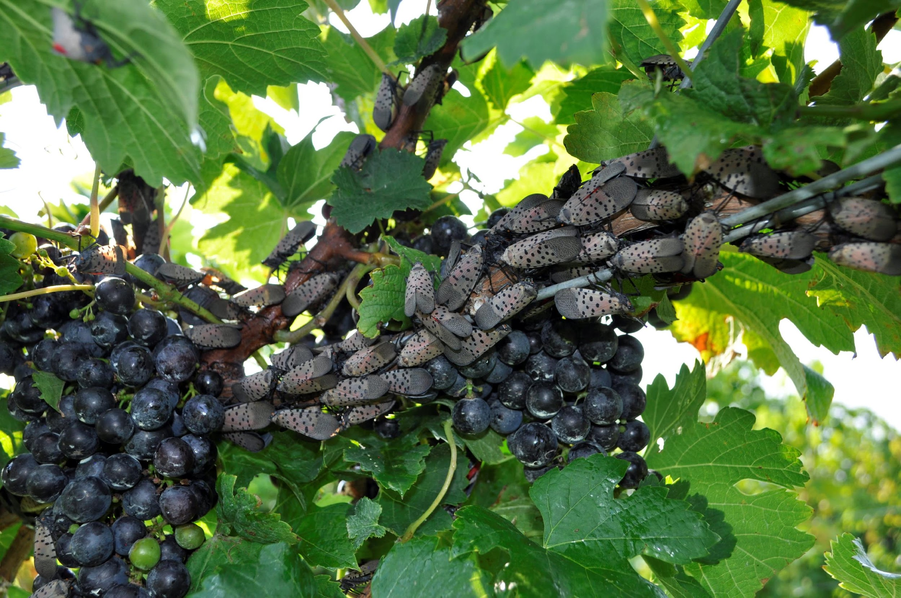
Spotted Lanternflies in Pennsylvania
Heather Leach, Penn State University
and on wine grapes
crowded on tree of heaven…
Spotted lanternflies. Photo by Erica Smyers
Notes:
Although it feeds on many plants, its favored breeding and feeding host is tree of heaven. It feeds on many fruit crops, but again favors wine grapes. On wine grapes, the honey-dew it leaves initiates mold on the fruit clusters. If enough lanternflies feed on a grape vine, it can kill the vine.

Slide 17
Spotted Lanternfly Utilization of Tree of Heaven
According to an East-Coast Pennsylvania State University-based paper published in Nature Scientific Reports in 2021 “Performance and host association of spotted lanternfly (Lycorma delicatula) among common woody ornamentals”
“Lycorma delicatula can complete development and reproduce without access to A. altissima” but “Fitness of the insect was greater in the presence of A. altissima. Survival was higher, development time was faster, and the number of egg masses was 6.8-fold higher than for insects that lacked access to A. altissima.”
“L. delicatula appears to sequester plant defensive chemicals [from tree of heaven] such as alkaloids and quassinoids as a defense against predation …”
“In prior work by Lee and colleagues, the authors reasoned that … preference for A. altissima and V. vinifera is related to high concentrations of sucrose and glucose in A. altissima sap, and high concentrations of sucrose and fructose in V. vinifera sap.”
Notes:
Spotted lanternfly can reproduce without tree of heaven, but survives better, develops faster, and reproduces at higher rates with access to tree of heaven. Feeding on three of heaven increases protection from predators.

Slide 18
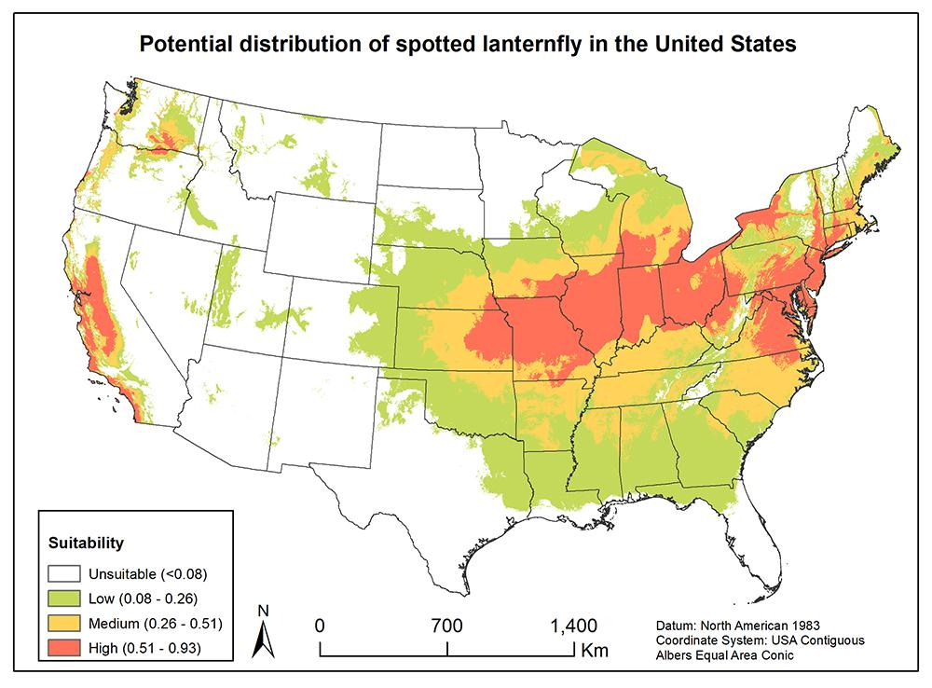
Notes:
The concern for California is that our grape growing areas are suitable habitat for spotted lanternfly. The likely method of infestation is the import of live egg cases on trucks, railcars, pallets, rock, or firewood.

Slide 19
From the 2023 CDFA
ACTION PLAN
For Spotted lanternfly (Lycorma delicatula)
California Department of Food and Agriculture
Plant Health and Pest Prevention Services Division
“The emerging consensus is that controlling Tree-of-heaven is crucial to controlling or preventing the establishment and spread of SLF.”
“In some situations, the presence of Tree-of-heaven may be critical to establishment of SLF. In these situations, removal of Tree-of-heaven may be the most effective means of preventing establishment of SLF.”
“Therefore, management tactics in California should balance lowering the chance of SLF establishment by removing Tree-of-heaven and preserving sentinel trees to ensure early detection of SLF.”
Notes:
The CDFA’s 2023 Spotted Lanternfly ACTION PLAN includes several references about the importance of controlling tree of heaven.

Slide 20
Notes:
The California Department of Food and Agriculture and the Pierce’s Disease/Glassy-winged Sharpshooter Board are actively trying to educate Californians about spotted lanternfly.
The Napa County Ag Commissioner office is also quite engaged in local SLF outreach.

Slide 21
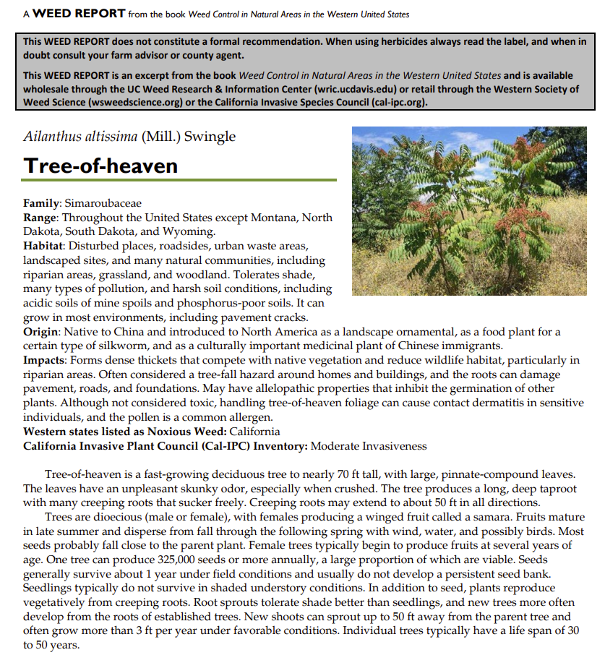

Slide 22
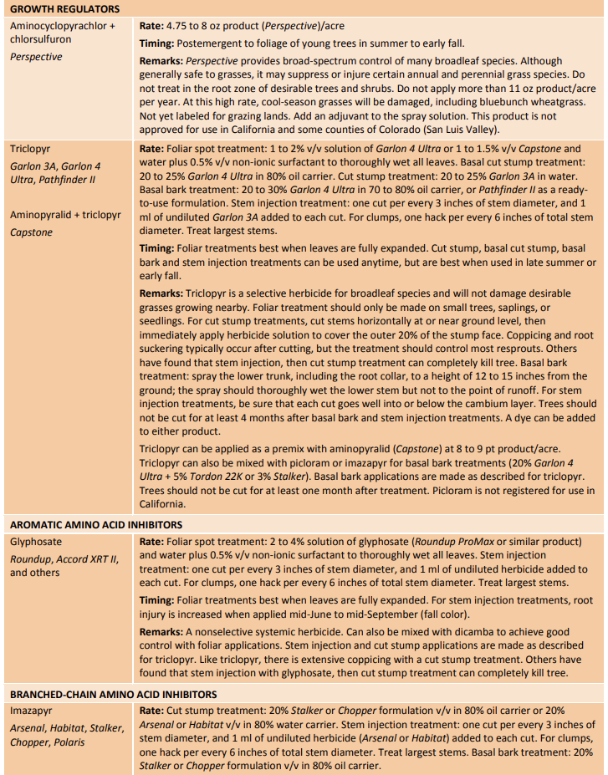
Chemical treatments for Tree of Heaven

Slide 23
Cut Stump
TreesAtlanta.org
TreesAtlanta.org

Slide 24
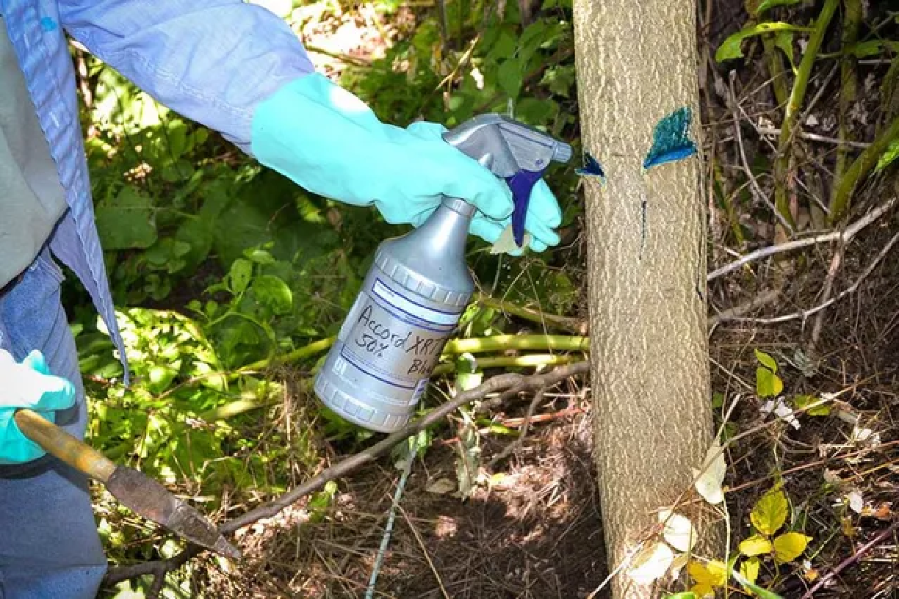
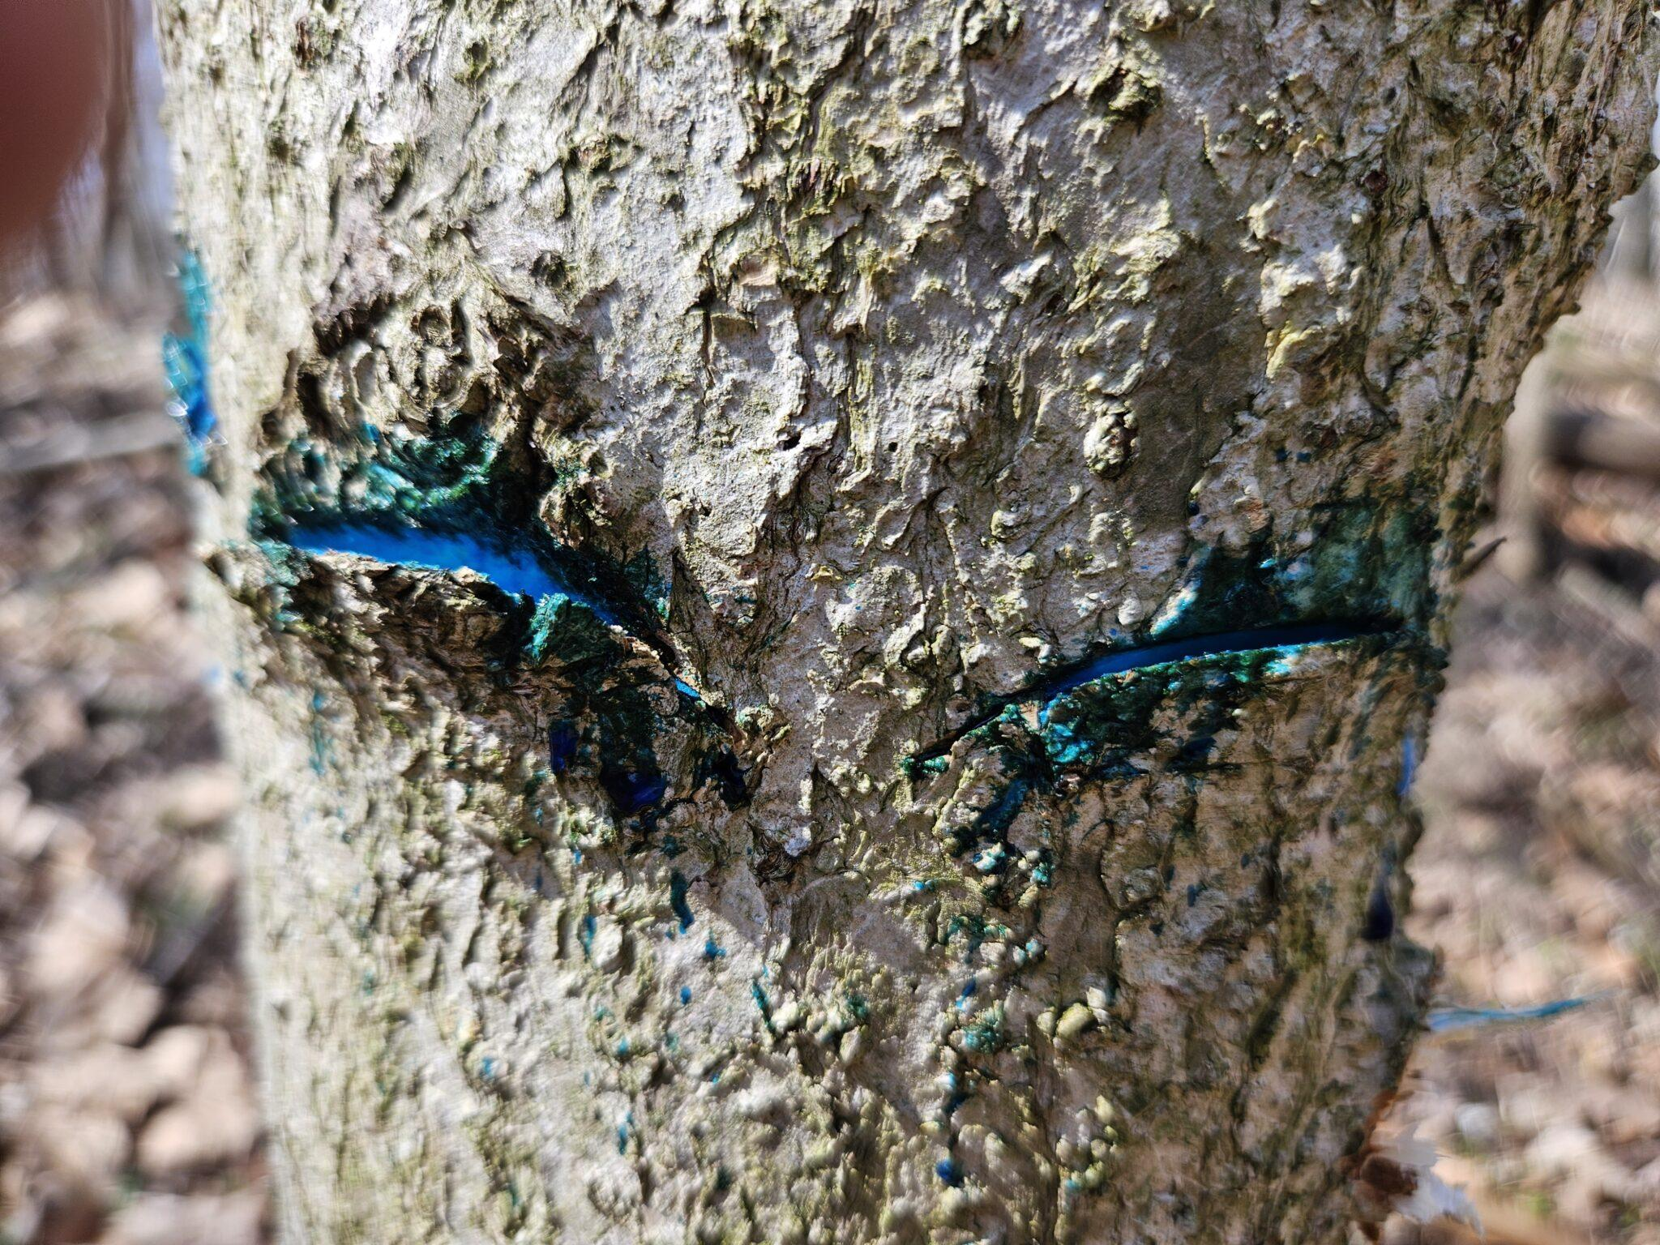
Hack and Squirt
Photo: Vincent Cotrone
Purdue University

Slide 25
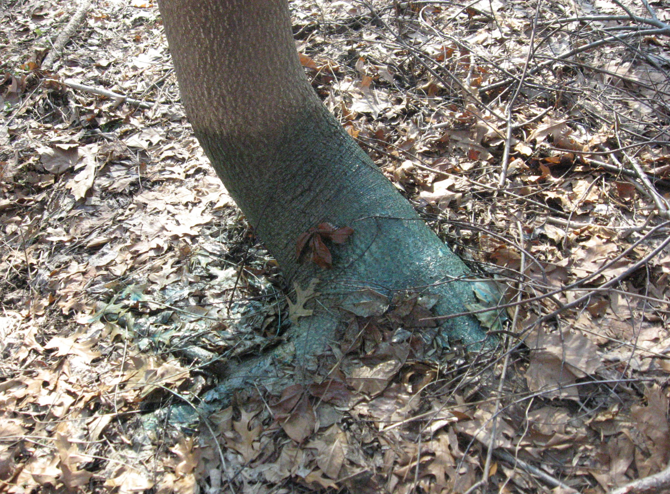
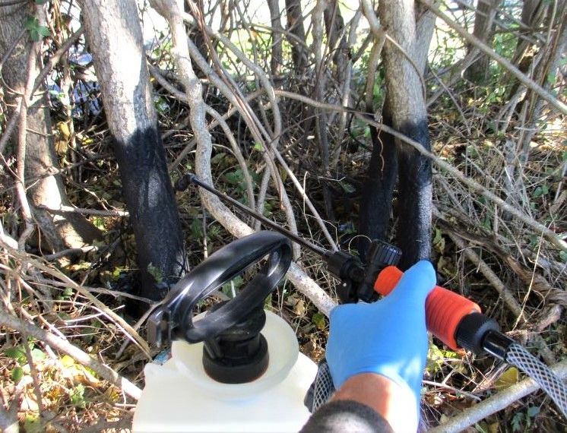
(Photo Credit: Steven K. Rettke, Rutgers Coop. Ext.)
Basal Spray
Maryland Invasive Species Council

Slide 26
Notes:
One efficient option is using an EZ-Ject lance that injects an herbicide shell into the tree’s bark.
I have no qualification or certification to recommend herbicides. My role is passing on information I’ve found.
The Ag Commissioner’s office has an EZ-Ject tool that they lend out.

Slide 27
EZ-Ject lance injecting shells into bark.
Notes:
Jamming the tool against the bark injects the herbicide shell.

Slide 28
Herbicide shells in Tree of Heaven
Notes:
Shells are placed every 2 to 4 inches of circumference around the tree. The recommended treatment season is late August through September/October. The tree then translocates the herbicide down into its roots as it senesces and drops its leaves that autumn.

Slide 29
Thank You
Chip Bouril
Chip.Bouril@USDA.gov
Leif Bryant
Leif.Bryant@CountyofNapa.org
Danielle Ashton
Danielle@NapaRCD.org

